Slide 1
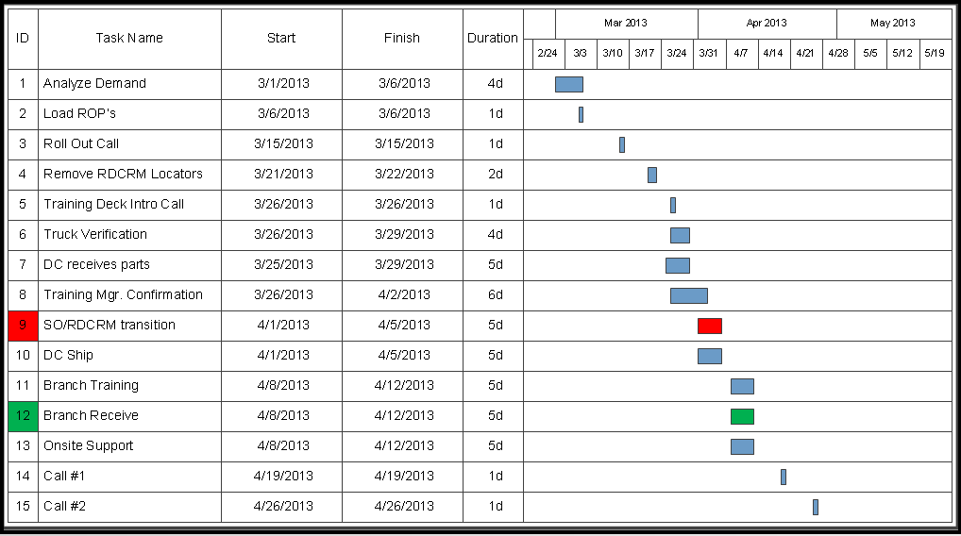

Service RDC Program Schedule
Completed

Slide 2
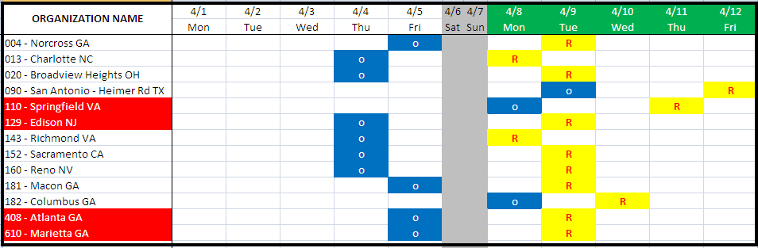

Order / Receipt Schedule

Slide 3
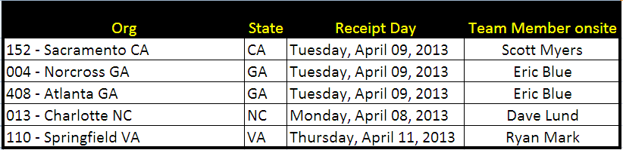
Onsite Support

